Slide 1
Oracle Integration Cloud
OIC Oracle Managed DR – Full Stack DR
Giovanni Conte
Black Belt - Integration
Notes:
Connectivité

Slide 2
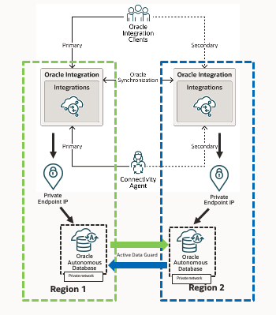
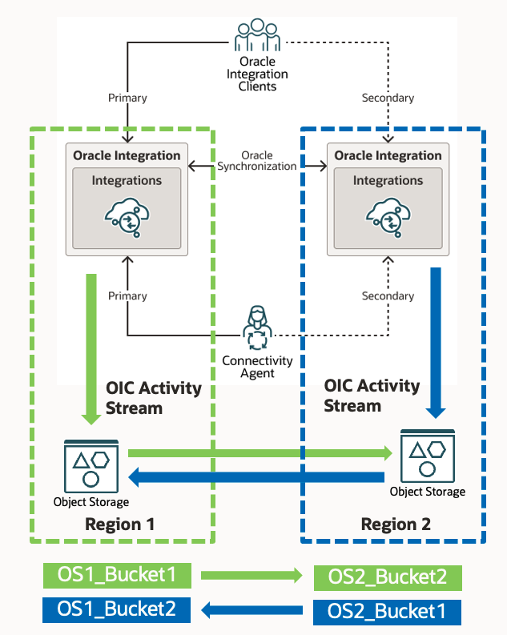
OIC Managed DR and Full Stack DR
Now available in Oracle Full Stack DR
https://docs.oracle.com/en/cloud/iaas/disaster-recovery/cssgm/prepare-integration-instance-disaster-recovery.html#GUID-106F9E71-FB25-4E2C-B537-D8BBB487EFCE
Previous demos / publications (OIC Oracle Managed DR):
OIC Oracle Managed DR - Private Endpoint and ATP Failover
https://www.youtube.com/watch?v=gdG_gOKKjPk
OIC Oracle Managed DR - Activity Stream DR
https://www.youtube.com/watch?v=geynD2nAE1M
In the above demos / publications we have seen how OIC Managed DR works by itself in conjunction with Switchover / Failover of other services (ATP, Objects Storage), managing Switchover / Failover activities on a per service basis (one service at a time).
Now we will see how Oracle Full Stack DR manages automatically the Switchover / Failover of al the services.
1
2
1
2

Slide 3
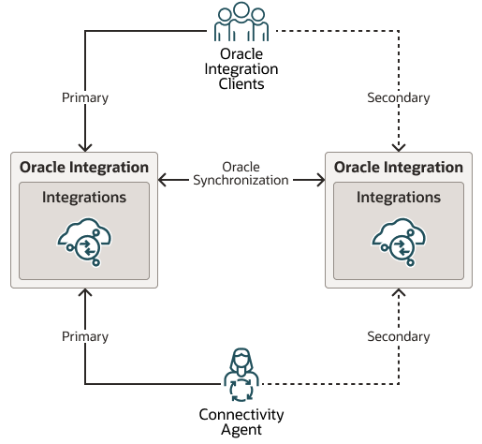
OIC DR: Failover for OIC and DB using OIC Private Endpoint and Full Stack DR
1
DR Protection Group / DR Plan
DR Protection Group / DR Plan
Private
Private
Endpoint IP
Endpoint IP
Oracle
Active Data Guard
Oracle
Autonomous
Autonomous
Database
Database
Private network
Private network
Region 1
Region 2
DR Plan
Execution

